Slide 1
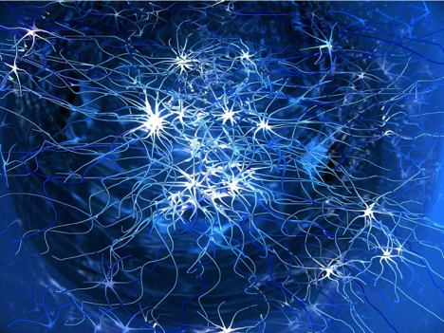
Convolutional Neural Networks
Submitted By
Kemanth PJ
Computer Science and Engineering
172CS015

Slide 2
Presentation Layout
Introduction
Drawbacks of previous neural networks
Applications of CNN
Steps involved in creating CNN
Inception V3 model
Disadvantages of CNN

Slide 3
Introduction
What are convolutional neural networks ?
Essentially neural networks that use convolution in place of general matrix multiplication in at least one of their layers.
A CNN makes predictions by looking at an image and then checking to see if certain components are present in that image or not. If they are, then it classifies that image accordingly.
They are very effective at image recognition and classification.

Slide 4
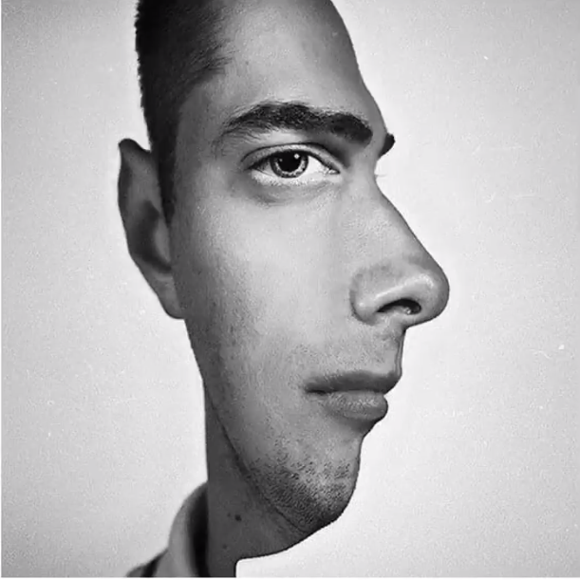
Convolutional Neural Networks
Motivation
This proves that our brain is looking for features when we see things
Our brain tries to classify images based on the centre of focus

Slide 5
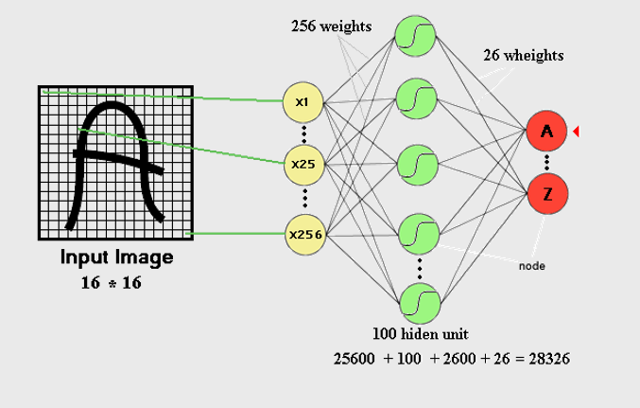
Disadvantage of previous neural networks
Number of trainable parameters become extremely large

Slide 6
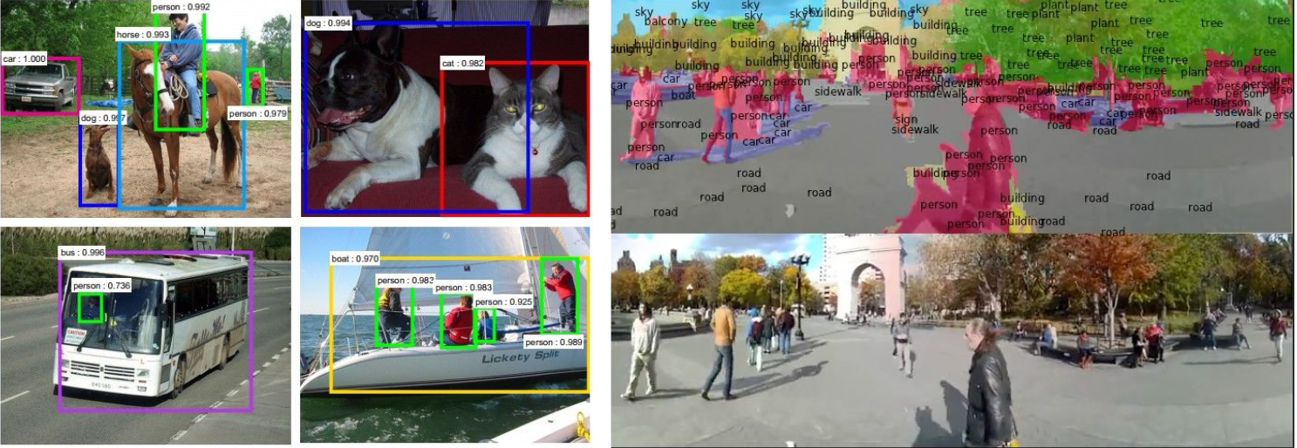
Applications of convolutional neural networks
The CNN is a deep learning architecture that has numerous application in computer vision and natural language processing, some of applications are
Image classification
Face identification
Handwritten document analysis

Slide 7
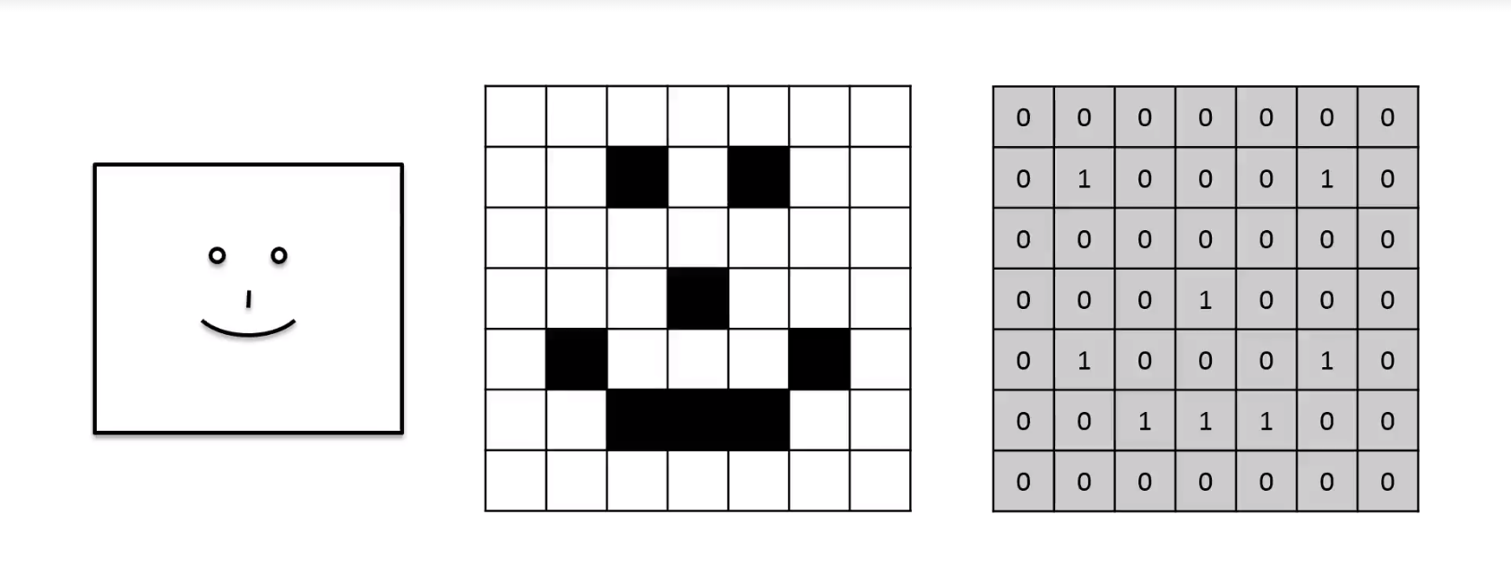
Let us take a simple image to understand how CNN’s work
1 – represents black pixel
0 – represents white pixel

Slide 8
Steps involved in creating CNN
Convolution
Pooling
Flattening
Full connection

Slide 9
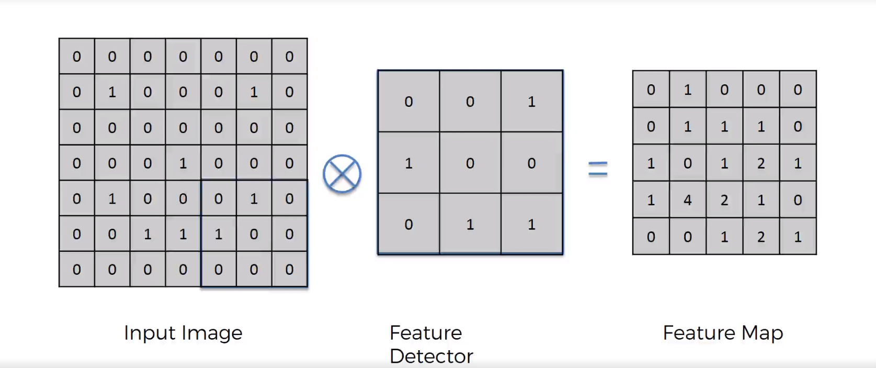
Step 1 - Convolution
Place the feature detector on top on input image and perform element wise multiplication and add all values then shift the detector by one cell and continue the process.

Slide 10


2D Convolution in Action
1 | 0 | 1
0 | 1 | 0
1 | 0 | 1
Feature Detector

Slide 11
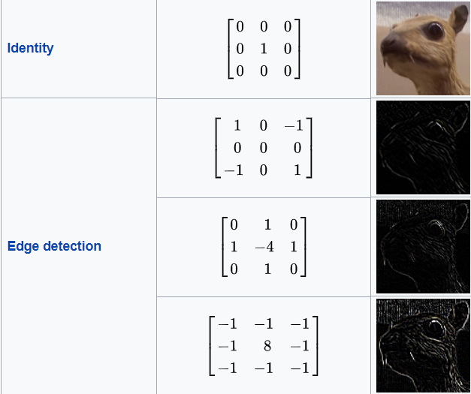
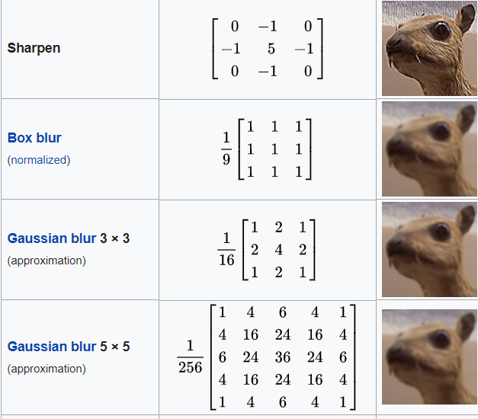
Some commonly used convolution detectors

Slide 12
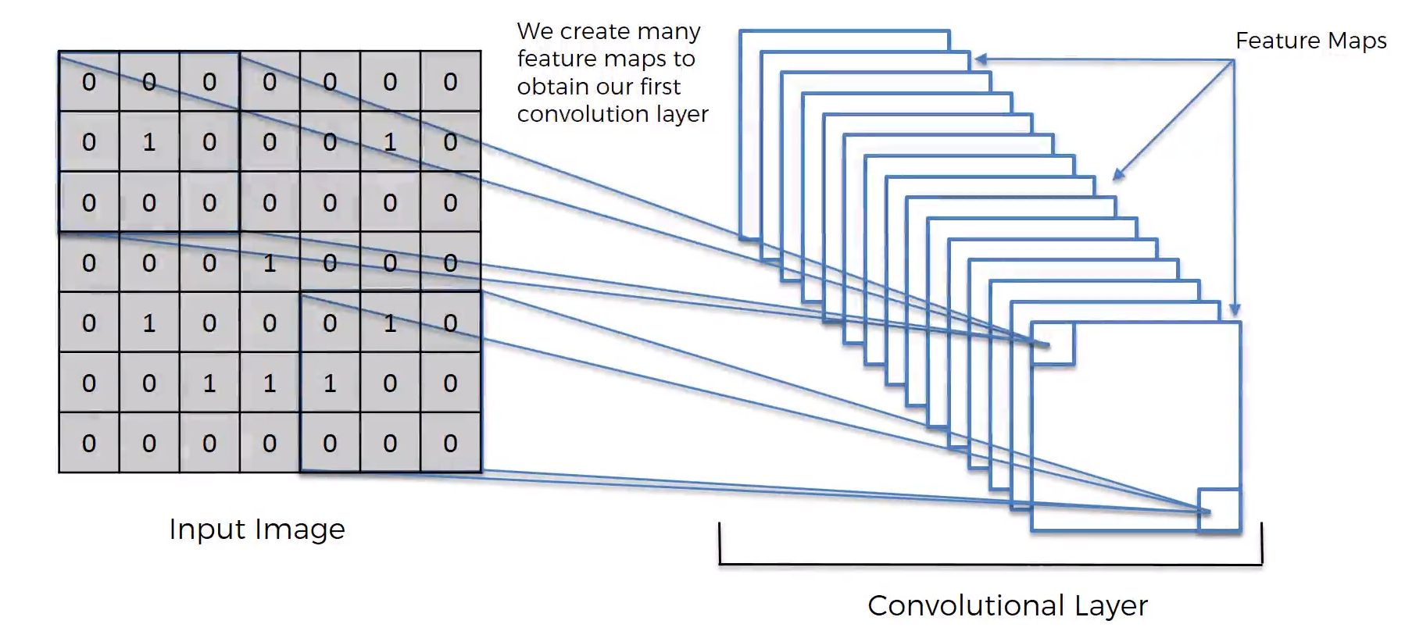
Use multiple feature detectors to create multiple feature maps

Slide 13
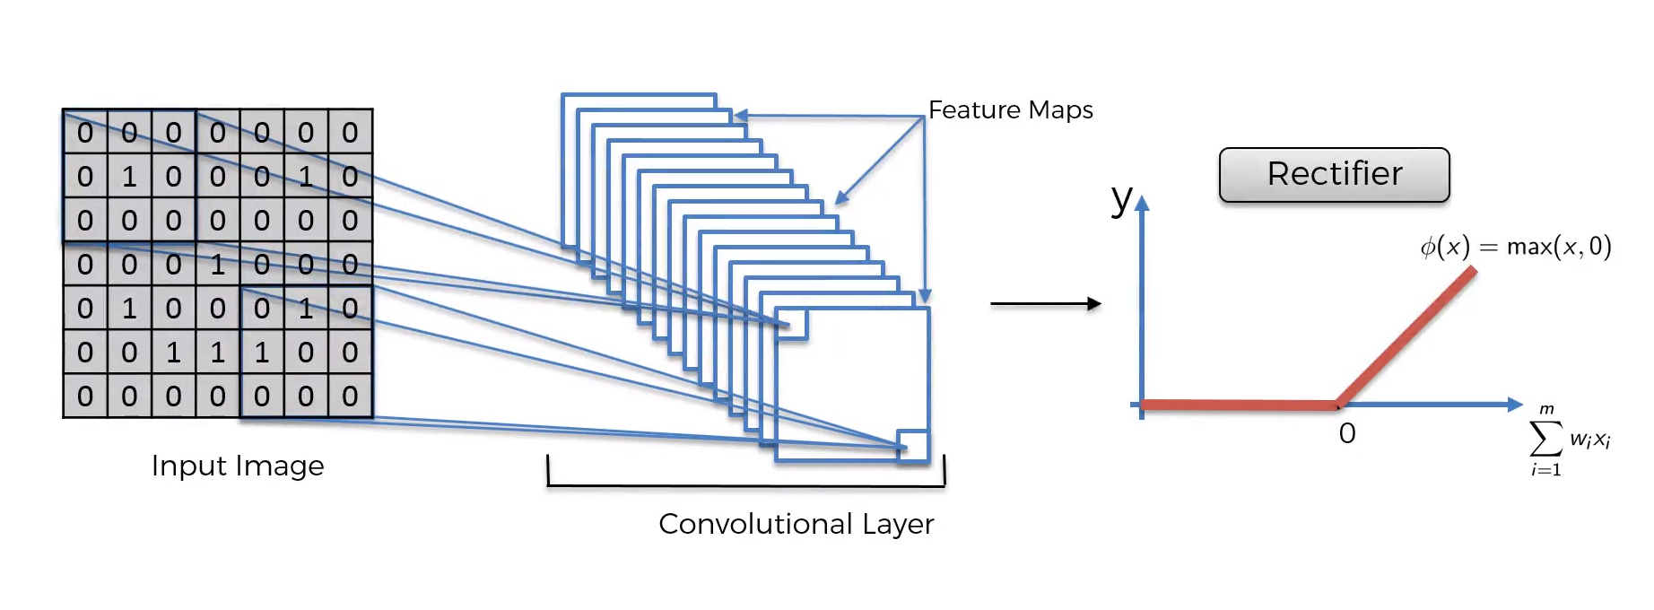
ReLu Layer

Slide 14
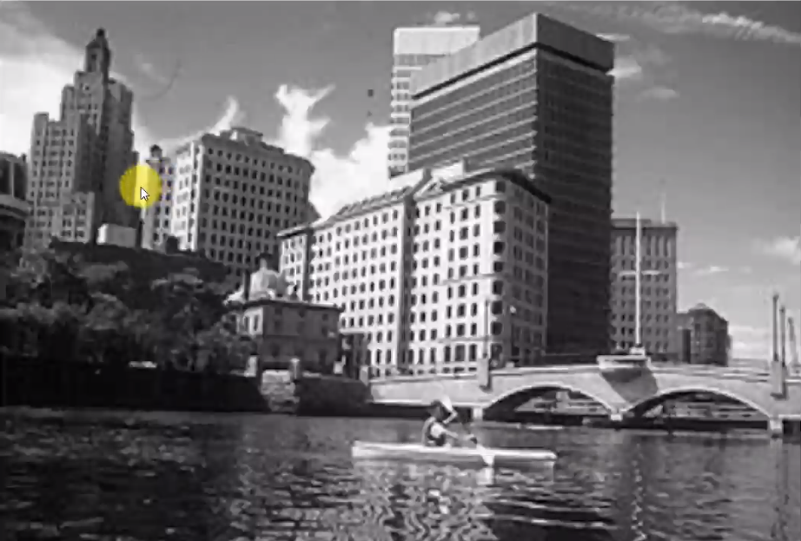
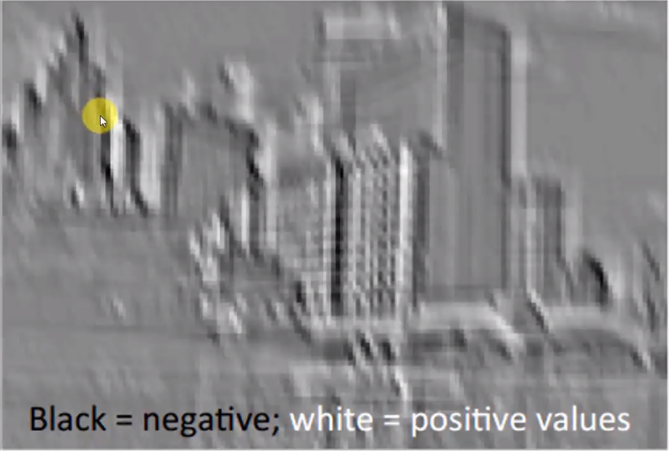
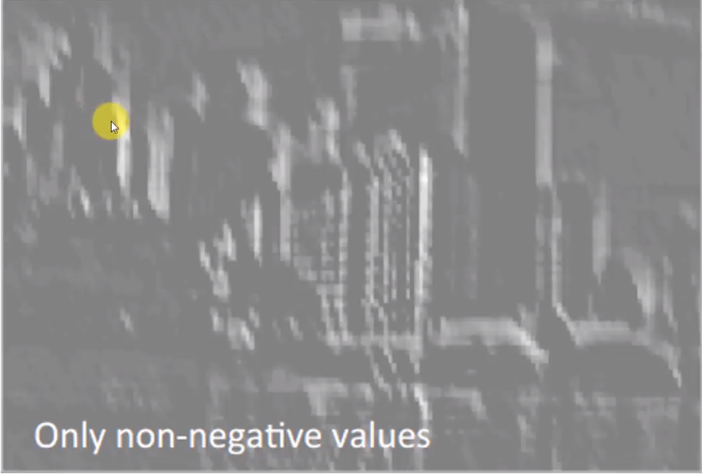
Without ReLu Layer
With ReLu Layer

Slide 15
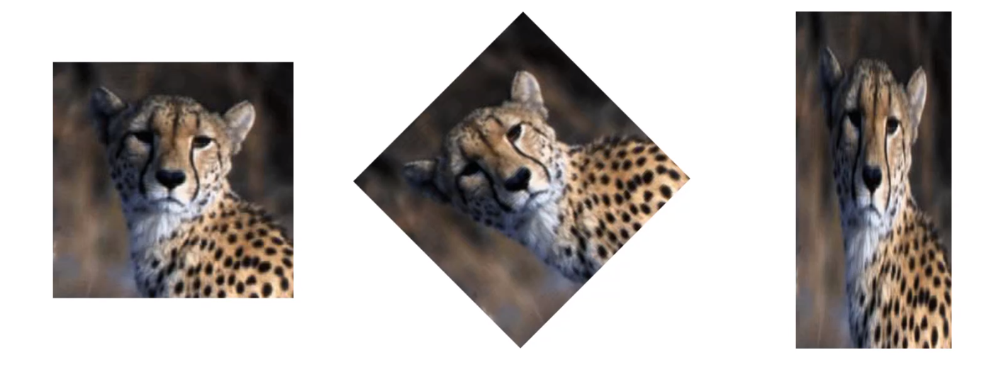
Step 2 - Pooling
We want the CNN to detect the cheetah correctly irrespective of the change in image orientation, sheer, position etc.
It also controls overfitting problem

Slide 16
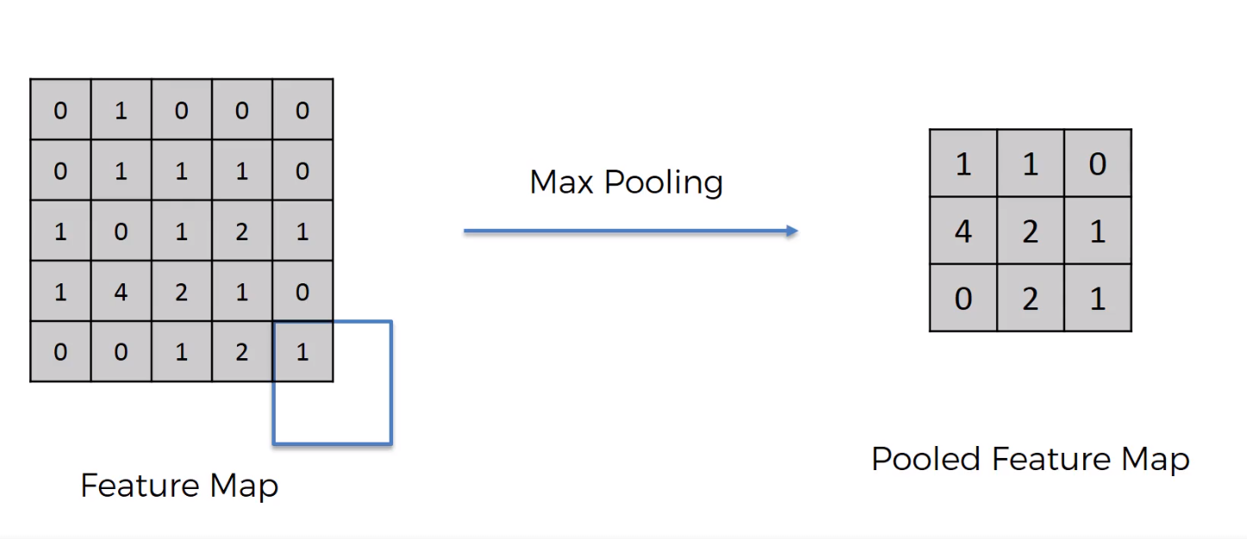
Max Pooling
Slide a n*n box over the feature map and take the maximum value
Essential features are preserved at the same time reducing the size of the feature map

Slide 17
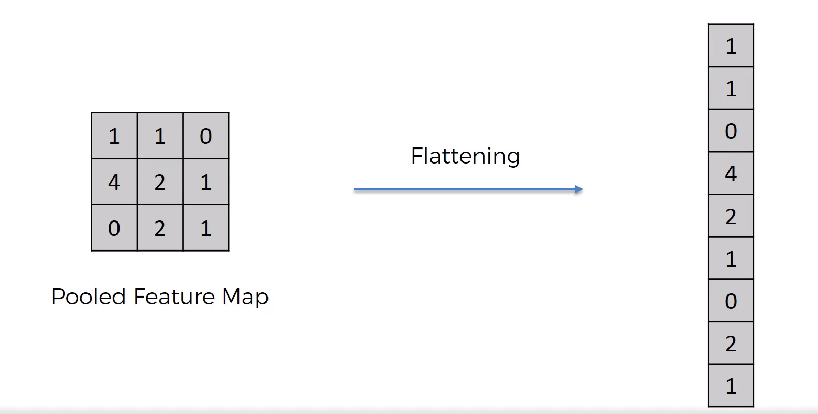
Step 3 - Flattening
Convert the 2D matrix to a column vector so that it can passed through an artificial neural network

Slide 18
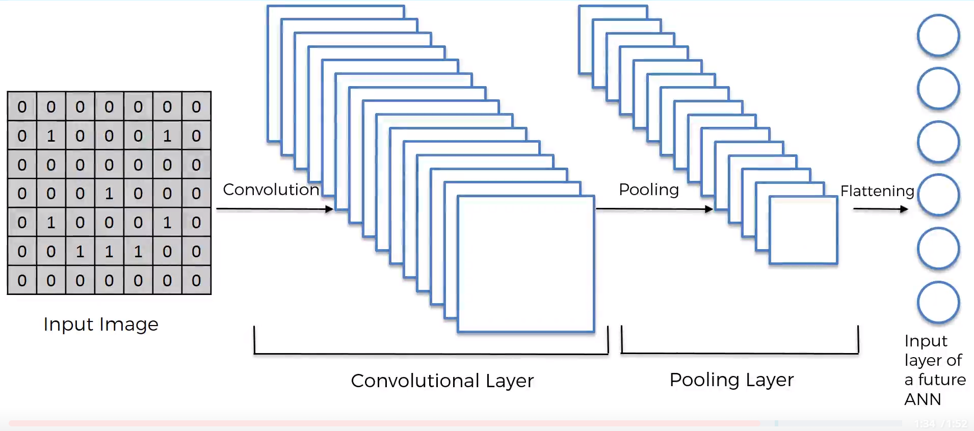
Summary so far

Slide 19
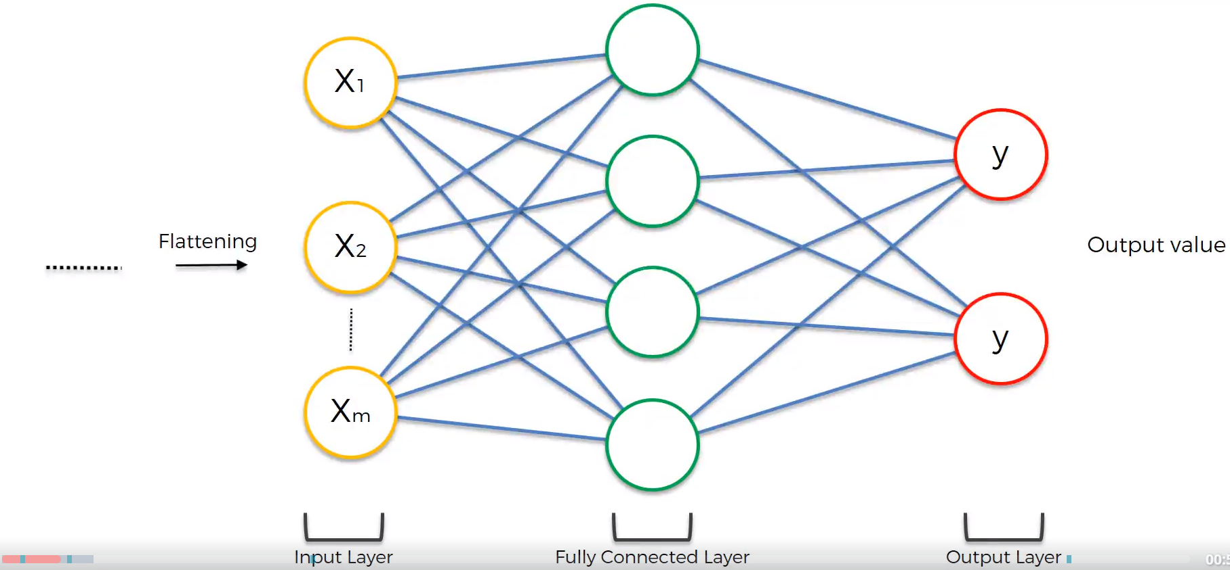
Step 4 – Full Connection
Connect the flattened layer to the fully connected Artificial neural network

Slide 20
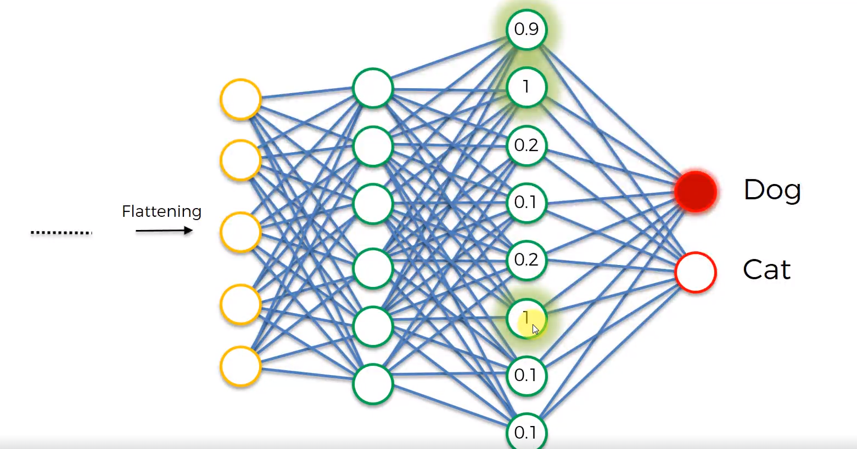

Slide 21
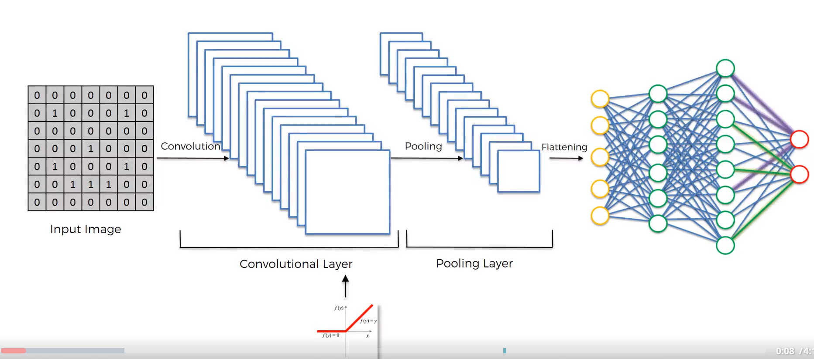
Final Model of CNN

Slide 22
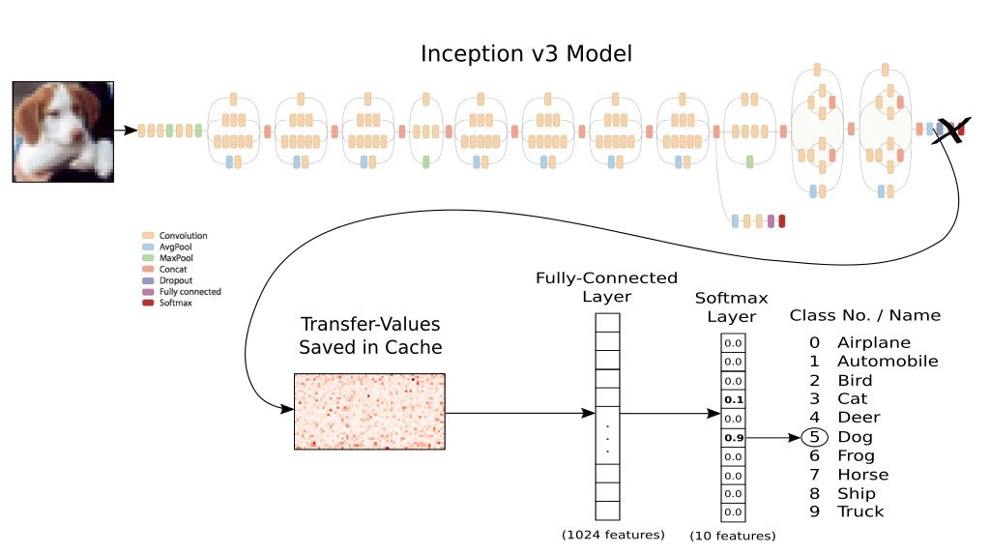
Popular CNN models
There are over 100 layers in this architecture.
It is trained on billions of images on “a few high-end GPUs within a week”.
These pre-trained CNN models can be reused for any image classification task by retraining last few layers.

Slide 23
Drawbacks of CNN
They do not encode the position and orientation of the object into their predictions
A CNN makes predictions by looking at an image and then checking to see if certain components are present in that image or not. If they are, then it classifies that image accordingly.
In a CNN, all low-level details are sent to all the higher level neurons.
If a lower level neuron has identified an ear, it then makes sense to send this information to a higher level neuron that deals with identifying faces and not to a neuron that identifies chairs.

Slide 24
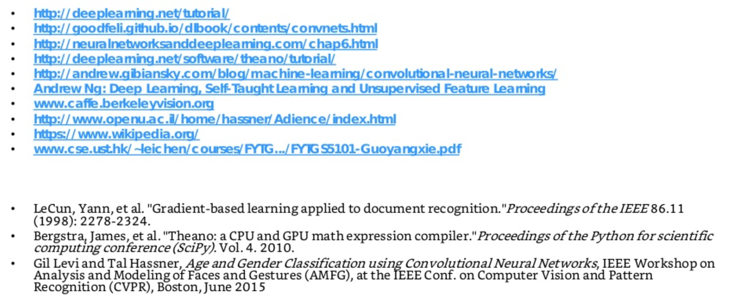
References

